Slide 1
The Process of Retiring From LLNS
Carol Christopher, Plan Administrator
HR Benefits Office
June 28, 2023

Slide 2
The Process of Retiring
TCP1 Retirees
TCP2 with UC Pension
TCP2 hired on or after 10/1/2007
Checking out
Health Insurance/Under age 65 and not Eligible for Medicare
Health Insurance/Eligible for Medicare

Slide 3
TCP1 Retirees
Start the process between 90 to 30 calendar days prior to your pension commencement date
Pension commencement date must be the first of the month
Your last day as an employee may be any business day prior to the first of the month

Slide 4
TCP1 Retirees (continued)
Option 1 (unless you have a Qualified Domestic Relations Order (QDRO) or eligible for the Restoration Plan)
Log onto Your Pension Resources (YPR)
Answer questions to create pension paperwork
Print paperwork – some items must be completed manually
Visit Notary Public
Scan and upload completed paperwork to YPR

Slide 5
TCP1 Retirees (continued)
Option 2
Phone the LLNS Pension Center
You will be asked for your spouse’s/contingent annuitant’s Social Security Number
Pension paperwork will be sent in approximately 3 weeks
Visit Notary Public
You either mail the completed documents to the LLNS Pension Center or scan and upload them to YPR

Slide 6
TCP1 Retirees (continued)
The Capital Accumulations Provision, (CAP), form is sent directly to UC
The address is at the top of the form
Pension payments are on the first of the month for that month

Slide 7
TCP2 with UC Pension
Not receiving UCRP
Contact UC to start pension
Receiving monthly pension
Send the Benefits Office proof
1099R
Monthly statement
Copy of bank deposit
Lump sum cash-out
Notify the Benefits Office
The information above determines your eligibility for the retiree health and welfare subsidy

Slide 8
TCP2 Hired on or After 10/1/2007
Contact the Benefit Office if you have questions about access only health coverage
Must have 10 or more years LLNS Service
Must be age 50 or older when retiring from LLNS

Slide 9
Checking Out
You notify your department of your intent to retire
Your department will give you the check out information
Your department will notify payroll
Final pay includes
Any hours worked since your last pay day
Any accrued unused vacation through your last day of employment

Slide 10
Enrolling in Health Insurance Under 65 and Not Eligible For Medicare
Contact Empyrean approximately 2 weeks after your last day of employment to enroll in:
Medical
Dental
Vision and/or
Legal
Empyrean will bill you monthly
You may set up a direct debit from a banking account

Slide 11
Enrolling in Health Insurance Medicare
90 days prior to the effective date of your retiree health insurance, contact Medicare to enroll in Medicare Parts A & B
Enroll in Kaiser Sr. Advantage or a Medicare supplement plan before the effective date of your retiree health insurance
Kaiser – contact Empyrean or the Benefits Office
Medicare supplement plan – contact Via Benefits
Contact Empyrean approximately 2 weeks after your last day of employment to enroll in:
Dental
Vision and/or
Legal

Slide 12
For More Information
LLNL BENEFITS OFFICE
Llnl-benefits@llnl.gov
https://benefits.llnl.gov
925-422-9955
LLNS Pension Center
https://ypr.aon.com/livermore
866-655-9587
Empyrean
www.llnsretireebenefits.com
1-844-750-5567
Via Benefits
https://my.viabenefits.com/
1-866-682-4841

Slide 13
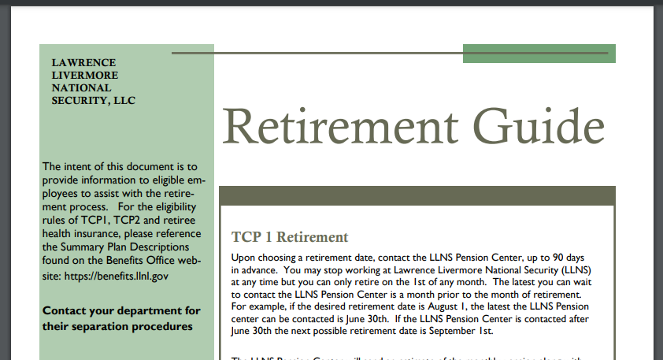
For More Information cont’d
The Retirement Guide
https://benefits.llnl.gov/retirement-savings/retirement-guide

Slide 14
?

