Slide 1


Understanding Medicare and Long-Term Care:
An Overview of Coverage and Options
Presented by HICAP
The Health Insurance Counseling and
Advocacy Program
&
Legal Assistance for Seniors

Slide 2
Legal Assistance for Seniors
Our mission is to ensure the independence and dignity of seniors by protecting their legal rights through education, counseling and advocacy.
Our legal, community education, and individual Medicare counseling services (through HICAP) are all free of charge.
LAS is a 501(c)(3) agency (non-profit) that has served seniors and others in Alameda county since 1976

Slide 3
LAS Helps With…
Government Benefits
(Social Security, SSI, CAPI)
Senior Immigrant Issues
Elder Abuse Prevention
Kin Caregiver Issues
Planning for the Future
Health Care Coverage
(Medicare & Medi-Cal)
Housing (limited case-by-case basis)

Slide 4
Health Insurance Counseling and Advocacy Program (HICAP)
HICAP provides assistance with Medicare and related health insurance by offering objective information to consumers about their benefits and options.

Slide 5
HICAP Services
LAS receives HICAP federal and state funds through the Alameda County Area Agency on Aging
HICAP Counselors are registered with the state of California & must fulfill continuing education requirements
LAS offers HICAP appointments at 30+ locations throughout Alameda County. (Phone counseling only during the Public Health Emergency)
LAS/HICAP provides educational presentations throughout the county to help Medicare beneficiaries know their rights and options
Difficult cases can be referred to the legal department
All services are free

Slide 6
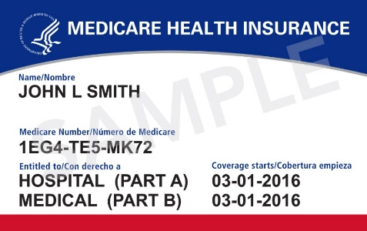
What is Medicare?
Federal government insurance program
Health insurance coverage for people 65 and over, and for people with disabilities
No financial eligibility requirements
You are eligible for Medicare if…
  You are a U.S. citizen or legal permanent resident with 5 years continuous residence and…
  You are 65 and older
  You are under 65 and have been getting Social Security disability income (SSDI) for at least 24 months
  No waiting period if:
    You have kidney failure (end stage renal disease)
    You have ALS (amyotrophic lateral sclerosis), aka Lou Gehrig’s disease.
  Apply through the Social Security Administration: www.ssa.gov or 1-800-772-1213

Slide 7

Medicare Coverage
Part A = Hospital Insurance
Part B = Medical Insurance
Part C = Medicare Advantage Plans
Part D = Prescription Drug Plans

Slide 8
Medicare Part A Costs
Free if eligible for Social Security benefits:
  With 40 quarters (10 years) or more of work
  Through spouse or former spouse (previous marriage of 10 years or more)
If not automatically eligible, premium is:
  $278/month with 30-39 quarters
  $506/month with 29 or fewer quarters
Notes:
This is down from $234 & $426 in 2014!!

Slide 9

Medicare Part A Covers
Inpatient Hospital Care
  Deductible: $1,600 per benefit period
Skilled Nursing
  Days 1-20: $0 co-pay
  Days 21-100: $200/day
Home Health Care
  Intermittent skilled care prescribed by doctor
Hospice
  Pain management program for terminally ill
Notes:
Benefit Period aka “spell of illness” =
starts the day the covered beneficiary is admitted to the hospital for a Medicare covered stay;
continues until 60 days after the end of the Medicare covered stay in the hospital or a skilled nursing facility stay;
There are upper limits on the number of days Medicare will cover in the hospital, and an additional lifetime cap on the total number of “reserve days”.
The reality though is that the average length of a Medicare covered hospital stay is less than 10 days.

Slide 10
Medicare Part B Costs
The Initial Enrollment Period is a 7-month window. It begins 3 months before your birth month, continues through your birth month, and lasts 3 months after your birth month.
*As of January 1, 2023, people who enroll in month 5-7 will have their Part B effective in the month after they enroll, without delay.
People who miss their IEP may qualify for a Special Enrollment Period (SEP) or they will have to enroll during the General Enrollment Period
(GEP, Jan-March annually).
*As of January 1, 2023, people who enroll in the GEP will no longer have to wait until July for coverage to become effective. It will begin the month following enrollment.
Most Medicare beneficiaries will pay a standard premium of $164.90/month in 2023.
There are 2 costs associated with Part B:
Annual deductible = $226 Co-insurance = 20%
Notes:
This is down from $234 & $426 in 2014!!

Slide 11
Medicare Part B Costs
Individuals with incomes over $97,000 and couples over $194,000 pay more:
Beneficiaries who file an individual tax return with income: | Beneficiaries who file a joint tax return with income: | Total monthly premium amount per person
Greater than $97,000 and less than or equal to $123,000 | Greater than $194,000 and less than or equal to $246,000 | $230.80
Greater than $123,000 and less than or equal to $153,000 | Greater than $246,000 and less than or equal to $306,000 | $329.70
Greater than $153,000 and less than or equal to $183,000 | Greater than $306,000 and less than or equal to $366,000 | $428.60
Greater than $183,000 and less than $500,000 | Greater than $366,000 and less than $750,000 | $527.50
Greater than or equal to $500,000 | Greater than or equal to $750,000 | $560.50
Notes:
This is down from $234 & $426 in 2014!!

Slide 12

Medicare Part B Covers
Physicians
Diagnostic Tests
Rehabilitation Services
Durable Medical Equipment
Ambulance
Mental Health Visits
Outpatient physical, occupational, speech therapy
  Care must be medically necessary and reasonable
  Medicare pays 80% of approved charges
Notes:
Mental Health Parity as of 2014: Medicare paid only 50% of approved rate in 2009, with the percentages increasing over 6 years to the usual level of 80% last year (2014). Due to MIPPA (7/15/2008). 190 days lifetime mental health inpatient cap.

Slide 13
Preventive Benefits Under Part B
Covered in Full Overview
Welcome to Medicare Exam
Annual Wellness Visit
Breast Cancer Screening
Cervical Cancer Screening including Human Papillomavirus (HPV) Testing
Colon Cancer Screening
Annual Fecal Occult Blood Test (for people 50 and over)
Colonoscopy
Flexible Sigmoidoscopy
Diabetes Screening
Heart Disease Screening
Nutritional Therapy for people with diabetes, ESRD, or a kidney transplant
Osteoporosis Screening
Prostate Cancer Screening
Smoking Cessation Counseling
Vaccinations
  Flu
  Pneumonia
  HEP C (high risk)
  COVID-19
  Shingles
13
Notes:
The Affordable Care Act provided more preventive care with fewer out of pocket costs.

Slide 14

Recently Added Preventive Benefits Under Part B
Starting in 2023, people with Medicare drug coverage will pay nothing out-of-pocket for adult vaccines recommended by the Advisory Committee on Immunization Practices (ACIP), including the shingles and Tetanus-Diphtheria-Whooping Cough vaccines
Reminder of benefits added in 2022
Bariatric Surgery when certain conditions related to morbid obesity exist
Cognitive assessment & care plan services
Blood-based biomarker test
COVID-19 related services
Added opioid risk assessment in “Welcome to Medicare” and yearly “Wellness” visit
14
Notes:
The Affordable Care Act provided more preventive care with fewer out of pocket costs.

Slide 15
Exclusions From Medicare Coverage
Routine dental care
Routine vision care
Routine hearing care
Routine foot care
Cosmetic Surgery
Experimental Procedures
Personal Care at home or in a nursing home (Long Term Care)

Slide 16
Medicare Part D
Separate insurance plans to cover prescription drugs
Offered through private insurance companies
In California in 2023:
  26 stand-alone plans
  4 Benchmark plans
*The Inflation Reduction Act caps insulin costs at $35/month beginning in 2023.
Plans vary in premiums, co-insurance, and formularies (lists of covered drugs)
    Must offer at least two choices in each drug category
    Different pricing tiers of drugs
Pharmacy network for each plan
Exceptions (appeals) process for non-formulary drugs
Can use www.Medicare.gov Plan Finder to find plan that best fits needs
Notes:
For 2017. Premiums range from ~ $15/month to more than $145.
Going down to 28 plans in 2016

Slide 17
Medicare Part D Enrollment
Annual Enrollment Period:
  October 15th – December 7th
  Enrollment takes effect January 1
Enroll through www.medicare.gov or directly with the company
Penalty for late enrollment unless one has creditable coverage (other Rx coverage as good as or better than the standard Part D benefit)
Penalty = 1% of national average premium ($34.71 in 2023) times the number of months eligible but not enrolled

Slide 18
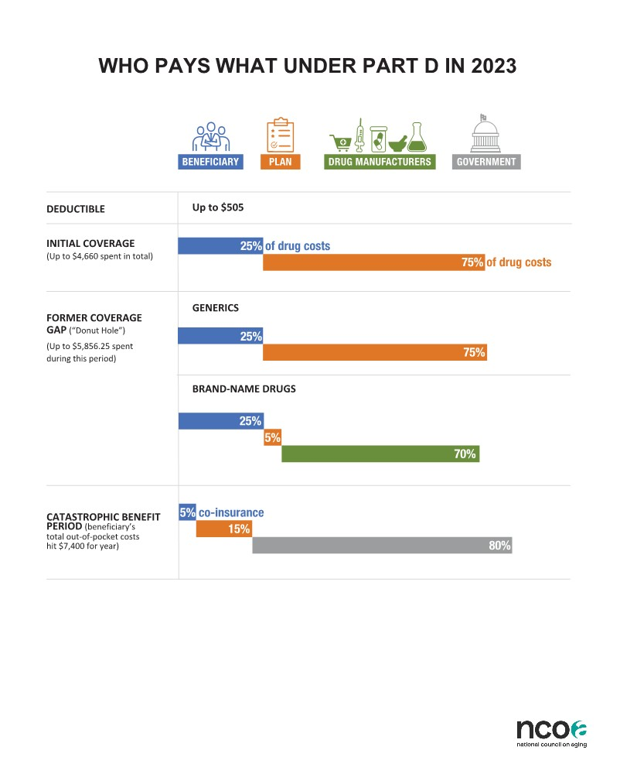
Medicare Part D Standard Benefit 2023
18
Notes:
Every PDP has to offer at least this level of coverage.
Deductible up from $320 and the 25% went from $660 to 737.50
Total Out of Pocket Costs = $360 + $737.50 (25% of the Initial Coverage Period: difference between $360 and $2,960) + $3,752.50 (Coverage Gap: $7062.50-$3310) = $4850.
Donut hole went up slightly to $3,720
Discount for generic drugs went up from 35% to 42%

Slide 19

Extra Help for Part D Costs
Also called the Low-Income Subsidy (LIS)
For those with limited income and assets:
  Individual: $1,720/mo. income; $15,510*/assets
  Couple: $2,309/mo. income; $30,950*/assets
    $1,500 burial expense per person not included
Pays all or part of the prescription drug plan premiums, deductibles, and co-pays
Benchmark or “standard” plans have $0 premium for people who qualify for full LIS
Pays for costs in the gap or “donut hole”
Can change plans once/quarter in the first 9 months of the year
Apply through Social Security www.ssa.gov

Slide 20

Ways to Supplement Medicare
Medigap Plans
Medicare Advantage Plans
Employer/Retirement Plans
Tri-Care for Life
VA Benefits
Medi-Cal
Medicare Savings Programs

Slide 21
In the Fee-For-Service System
(Original Medicare)
First: the person receives treatment (from a doctor, lab, hospital, SNF, home health agency)
Then: Medicare, supplemental insurance, and/or the person are billed
Billing and
Payment
Services

Slide 22
Medigap Policies and the Fee-For-Service System
11 “standardized” policies
Policies pay after Medicare pays
No network restrictions
Policies fill Medicare “gaps,”
- Co-insurance, deductibles
Guarantee Issue Period for 6 months from the date Part B starts
All companies must offer Plan A
(the basic benefit package)
Notes:
Plans go from A through N (2- F plans; no J plan). Medigaps can impose a health screening/medical underwriting at anytime. Two plans (K and L) have out of pocket limits but cover percentages of the co-pays and co-insurance. One plan (F) has a high deductible option of $2,000. Must pay that amount in co-pays and coinsurance before plan starts covering. Premiums are substantially lower for this plan.
Essentially, Medi-gaps offer more freedom of choice for higher premiums.

Slide 23

Part C: Medicare Advantage Plans
Insurance companies contract with Medicare on annual basis… and create networks of local medical groups & hospitals
The MA plan receives an upfront monthly payment from Medicare for each enrollee
Then the MA plan provides and coordinates the services to its members
Plan offerings and costs vary by county
Premiums and benefits can change annually
Compare health and drug plans at: www.medicare.gov
Notes:
According to the National Council on Aging, in 2010 Medicare Advantage Plans were paid about $1100 more per person than what was paid for people in original Medicare. Beginning last year, rates are being gradually reduced so they’ll be about the same as rates under original Medicare (by 2016). MA plans are not allowed to cut any benefits provided under original Medicare. Medicare is also offering incentives & levying penalties based on quality or star ratings. Ratings data is included in the Plan Finder at medicare.gov.

Slide 24

MA Enrollment and Eligibility
Annual Election Period:
  October 15 - December 7
MA Open Enrollment Period:
  January 1 – March 31
Generally, people can change plans only once a year
Enroll through www.medicare.gov or directly with the company
Eligibility: Must have Medicare Part A & Part B
  Beneficiaries who have ESRD are eligible as of 1/1/2021
  Most MA plans include Part D drug coverage

Slide 25

Medicare Advantage Plans
- Health Maintenance Organizations (HMOs)
- Preferred Provider Organizations (PPOs)
- Private Fee For Service Plans (PFFS)
- Medical Savings Accounts (MSAs)
- Special Needs Plans (SNPs)
*Most HMOs, PPOs, and SNPs include Part D coverage
Notes:
Every year there are changes! For 2016 there will be 8 HMO plans instead of 10 in 2015. SNPs are staying the same:
D-SNPs are for those with Medicare and full Medi-Cal (duals):
Kaiser Sr. Advantage Medicare Medi-Cal Plan
Care 1st Total Dual Plan (Alameda, Albany, Berkeley, Emeryville, and Oakland only)
D-SNPs have $0 premiums and few co-pays and they include Part D coverage with the full subsidy.
PACE Plans in Alameda County:
Center for Elders Independence
(North & Central County only)
On Lok Lifeways
(Fremont, Newark, Union City only)
PACE plans operate like SNPs, but provide additional services and have more eligibility restrictions (age 55+, at risk of institutionalization).

Slide 26
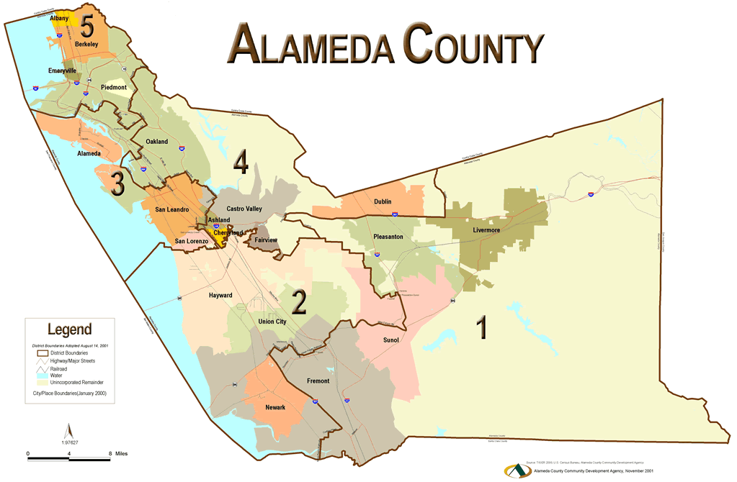
Alameda County
Medicare Advantage Plans 2023
Aetna:
Medicare Plus HMO $0
Medicare Select HMO $0
Medicare Eagle HMO $0 (no RX coverage)
Medicare Eagle Plus PPO $0 (no RX coverage)
Medicare Elite PPO $0
Alignment Health Plan:
CalPlus + Veterans HMO $0
Harmony HMO $0
My Choice CalPlus HMO $0
Premium HMO $69
Anthem Blue Cross:
MediBlue Select HMO $0
MediBlue Coordination Plus HMO $19.70/$0
“Mirror/Look Alike” are for any beneficiary for a monthly premium. For those with Medicare and full Medi-Cal (duals); they have $0 premiums, few copays, and include Part D coverage with the full subsidy.
Notes:
Every year there are changes! For 2016 there will be 8 HMO plans instead of 10 in 2015. SNPs are staying the same:
D-SNPs are for those with Medicare and full Medi-Cal (duals):
Kaiser Sr. Advantage Medicare Medi-Cal Plan
Care 1st Total Dual Plan (Alameda, Albany, Berkeley, Emeryville, and Oakland only)
D-SNPs have $0 premiums and few co-pays and they include Part D coverage with the full subsidy.
PACE Plans in Alameda County:
Center for Elders Independence
(North & Central County only)
On Lok Lifeways
(Fremont, Newark, Union City only)
PACE plans operate like SNPs, but provide additional services and have more eligibility restrictions (age 55+, at risk of institutionalization).

Slide 27
Alameda County
Medicare Advantage Plans 2023
Blue Shield of CA:
Blue Shield Inspire HMO $0
Blue Shield Select PPO $57
Brand New Day:
Classic Care I HMO $38.90/$0
Classic Care II HMO $0
Central Health Medicare Plan
Central Health Premier Plan I HMO $0
Central Health Premier Plan II HMO $34.50/$0
Essence Health Care
(formerly Stanford Healthcare Advantage):
Essence Advantage Gold HMO $57
Essence Advantage Platinum HMO $87
Imperial Health Plan of CA:
Imperial Traditional HMO $0
Imperial Strong HMO $0
Imperial Dynamic HMO $0
Imperial Courage HMO $0 (no RX coverage)
Kaiser:
Senior Advantage Basic Alameda HMO $0
Senior Advantage HMO $70
SCAN Health Plan:
SCAN Classic HMO $0
Notes:
Every year there are changes! For 2016 there will be 8 HMO plans instead of 10 in 2015. SNPs are staying the same:
D-SNPs are for those with Medicare and full Medi-Cal (duals):
Kaiser Sr. Advantage Medicare Medi-Cal Plan
Care 1st Total Dual Plan (Alameda, Albany, Berkeley, Emeryville, and Oakland only)
D-SNPs have $0 premiums and few co-pays and they include Part D coverage with the full subsidy.
PACE Plans in Alameda County:
Center for Elders Independence
(North & Central County only)
On Lok Lifeways
(Fremont, Newark, Union City only)
PACE plans operate like SNPs, but provide additional services and have more eligibility restrictions (age 55+, at risk of institutionalization).

Slide 28

Alameda County
Medicare Advantage Plans 2023
United Health Care:
Canopy Health HMO $57
AARP Medicare Advantage Focus HMO $25
AARP Medicare Advantage Secure Horizons Plan 1 HMO $118
Medicare Advantage Assure HMO $27.50/$0
Medicare Advantage Choice Plan 1 PPO $45
Medicare Advantage Choice Plan 2 PPO $0
Wellcare by Health Net:
Patriot Giveback HMO $0 (no RX coverage)
No Premium HMO $0
Premium Ultra HMO $133
“Mirror/Look Alike” are for any beneficiary for a monthly premium. For those with Medicare and full Medi-Cal (duals); they have $0 premiums and few co-pays and they include Part D coverage with the full subsidy.
Notes:
Every year there are changes! For 2016 there will be 8 HMO plans instead of 10 in 2015. SNPs are staying the same:
D-SNPs are for those with Medicare and full Medi-Cal (duals):
Kaiser Sr. Advantage Medicare Medi-Cal Plan
Care 1st Total Dual Plan (Alameda, Albany, Berkeley, Emeryville, and Oakland only)
D-SNPs have $0 premiums and few co-pays and they include Part D coverage with the full subsidy.
PACE Plans in Alameda County:
Center for Elders Independence
(North & Central County only)
On Lok Lifeways
(Fremont, Newark, Union City only)
PACE plans operate like SNPs, but provide additional services and have more eligibility restrictions (age 55+, at risk of institutionalization).

Slide 29
Alameda County MA Plans for
People with Special Needs in 2023
C-SNPs, D-SNPs, and I-SNPs are for those with certain chronic conditions, those with Medicare and full Medi-Cal (duals), or those in skilled nursing/long-term care facilities. D-SNPs have $0 premiums and few co-pays and they include Part D coverage with the full low-income subsidy.
Aetna:
Medicare Preferred D-SNP $0
Align Senior Care:
Connect C-SNP (Dementia) $0
Kidney Care C-SNP (ESRD w/dialysis) $38.90
Premier I-SNP (LTC Facility or Home) $38.90
Thrive I-SNP (LTC Facility or Home) $0
Alignment Health Plan:
Heart and Diabetes C-SNP $0
Anthem Blue Cross:
MediBlue Dual Advantage D-SNP $0
Brand New Day:
Dual Access D-SNP $0
Embrace Care Plan C-SNP $0
(Cardiovascular disorders, chronic heart failure, and diabetes)
Embrace Choice Plan C-SNP $38.90
(Cardiovascular disorders, chronic heart failure, and diabetes)
Select Care II I-SNP $0
(LTC Facility or Home)
Select Choice II I-SNP $33.20
(LTC Facility or Home)
Notes:
Every year there are changes! For 2016 there will be 8 HMO plans instead of 10 in 2015. SNPs are staying the same:
D-SNPs are for those with Medicare and full Medi-Cal (duals):
Kaiser Sr. Advantage Medicare Medi-Cal Plan
Care 1st Total Dual Plan (Alameda, Albany, Berkeley, Emeryville, and Oakland only)
D-SNPs have $0 premiums and few co-pays and they include Part D coverage with the full subsidy.
PACE Plans in Alameda County:
Center for Elders Independence
(North & Central County only)
On Lok Lifeways
(Fremont, Newark, Union City only)
PACE plans operate like SNPs, but provide additional services and have more eligibility restrictions (age 55+, at risk of institutionalization).

Slide 30
Alameda County MA Plans for
People with Special Needs in 2023
Central Health Medicare Plan
Focus Plan C-SNP $0
(Cardiovascular disorders, chronic heart failure, and diabetes)
Imperial Health Plan of CA:
Senior Value C-SNP $0
(Cardiovascular disorders, chronic heart failure, and diabetes)
Dual D-SNP $0
Kaiser
Medicare Medi-Cal North (Medi-Medi) $0
SCAN:
Balance C-SNP (Diabetes) $0
Heart First C-SNP $0 (Cardiovascular disorders and chronic heart failure)
United Health Care
Dual Complete D-SNP $0
Wellcare
Dual Liberty Amber D-SNP $0
PACE plans operate like SNPs,
but provide additional services and
have more eligibility restrictions
age 55+
at risk of institutionalization
          Center for Elders Independence: $0
          - for those with Medicare and full Medi-Cal
          - North & Central County only
    On Lok Lifeways: $0
    - for those with Medicare and full Medi-Cal
    - South County only
Notes:
Every year there are changes! For 2016 there will be 8 HMO plans instead of 10 in 2015. SNPs are staying the same:
D-SNPs are for those with Medicare and full Medi-Cal (duals):
Kaiser Sr. Advantage Medicare Medi-Cal Plan
Care 1st Total Dual Plan (Alameda, Albany, Berkeley, Emeryville, and Oakland only)
D-SNPs have $0 premiums and few co-pays and they include Part D coverage with the full subsidy.
PACE Plans in Alameda County:
Center for Elders Independence
(North & Central County only)
On Lok Lifeways
(Fremont, Newark, Union City only)
PACE plans operate like SNPs, but provide additional services and have more eligibility restrictions (age 55+, at risk of institutionalization).

Slide 31

Employer/Retiree Health Benefits
Employer-based coverage that may precede or supplement Medicare coverage
Costs and benefits vary widely
  Depends on employer
May include Rx coverage
  Check to see if it is the same as or better than Part D (creditable)
  Employer must provide annual notice whether creditable or not
Notes:
* Creditable coverage notices (it isn’t always a letter), goes out by October 15 (formerly 9/30 each year).

Slide 32

Tri-Care for Life or Veteran’s Benefits
Health coverage for Military retirees and their spouses
Supplements Medicare and pays after any other supplemental plan
Rx coverage is creditable to Part D
No monthly premium
1-800-538-9552 or
www.tricare.osd.mil/tfl
For veterans who served in the U.S. Armed Forces on active duty
Service Connection
  No monthly premiums; varying co-payments depending on priority ranking
Separate health care system
  Must use VA facilities
  No coordination with Medicare
  Medicare enrollment is optional
Rx coverage is creditable to Medicare Part D
1-800-827-1000, www.va.gov, or seek help from the county Veteran’s Service and Assistance office
Notes:
Separate system from Medicare (just as with V.A.)

Slide 33

Medi-Cal
California’s version of Medicaid
For those who have low incomes and limited assets
Pays for “medically necessary” health care and treatment
Payer of last resort
Income limits for aged, blind, disabled:
- $1,696/individual and $2,287/couple
Asset limits for Medi-Cal:
  - $130,000/individual; $195,000/couple

Slide 34

Medicare Savings Programs
Federal programs for those who have low incomes and limited assets:
Qualified Medicare Beneficiary (QMB)
  Pays Medicare Part A & B premiums, deductibles, and co-insurances
  Income Limits: $1,215 (single); $1,643 (couple)
  Asset Limits: $130,000 (single); $195,000 (couple)

Slide 35
Medicare Savings Programs
Specified Low Income Beneficiary (SLMB)
  Pays Medicare Part B premium
  Income Limits: $1,458 (single); $1,972 (couple)
  Asset Limits: $130,000 (single); $195,000 (couple)
Qualified Individual 1 Program (QI-1)
  Pays Medicare Part B premium
  Income Limits: $1,640 (single); $2,219 (couple)
  Asset Limits: $130,000 (single); $195,000 (couple)

Slide 36

Balance Billing
Not Allowed for Full Duals
Can your provider bill you if you have Medicare and Medi-Cal and/or the Medicare Savings Program called QMB?
  This is called “Balance Billing” and is not allowed.
  Some providers are not aware that they cannot bill for deductibles, co-payments, or co-insurance.
  Federal and State laws say that Medicare and Medi-Cal payments received by the provider must be considered
  payment in full.
  You have no legal obligation to pay anything further for any Medicare cost sharing.
    But do not ignore the bills that may come;
    talk to the doctor’s office or call HICAP for help.
Notes:
Section 1902(n)(3)(B) of the Social Security Act, as modified by Section 4714 of the balanced Budget Act of 1997, prohibits Medicare providers from balance billing QMBs for Medicare cost sharing.
Example of provider payment Medicare allowed amount for office visit $100 Medicare pays provider $80 Medicaid allowed amount for office visit $70 Medicaid pays provider $0

Slide 37

A Word About Medicare Fraud
Every year the Medicare program loses billions of dollars to waste, fraud, and abuse
  Estimated at 10% of annual budget
Fraud Fighting Efforts:
  Federal Task Force = HEAT
  www.stopmedicarefraud.gov
  Senior Medicare Patrol (SMP) programs
Your Medicare Card is Your Healthcare Credit Card

Slide 38

Report Medicare Fraud
HICAP: 1-800-434-0222
CA Senior Medicare Patrol:
1-855-613-7080
Medicare: 1-800-MEDICARE
Office of Inspector General:
1-800-447-8477
FTC ID Theft Hotline:
1-877-438-4338

Slide 39

More Resources
Medicare Website: www.medicare.gov or 1-800-Medicare
  Comparison and quality of care information on Medicare Advantage and Prescription Drug Plans; questions and complaints related to Medicare; help with plan comparisons
California Health Advocates: www.cahealthadvocates.org
  Fact sheets and other information about Medicare and related health insurance topics
Department of Insurance: www.insurance.ca.gov
  1-800-427-9357
  Consumer information, Medigap company list and sample premiums; Long term care insurance info; complaints regarding insurance policies and agents

Slide 40

LONG TERM CARE INSURANCE
Is It Right For You?
What is Long Term Care?
Assistance with personal care provided over a long period of time
  - at home
  - in the community
  - in nursing homes

Slide 41
Long Term Care Often Defined As:
Needing Assistance with
Activities of Daily Living
ADLs Also Measured by Cognitive Impairment
Bathing
Dressing
Eating
Toileting
Continence
Transferring
Ambulating
  Need supervision and reminding
  Safety issues for self or others
  Help with Instrumental Activities of
  Daily Living:
  Managing medications
  Managing money
  Housework
  Shopping for groceries or clothing
  Use of telephone or other form of
  communication
  Transportation within the community

Slide 42
Who Needs Long Term Care?
Projected Need for LTSS:
70% can anticipate some form of long term support and services
42% will have a need that lasts less than a year at home
13% will have a need that lasts less than a year in a facility
Average duration is 3 years (3.7 years women, 2.2 years men)
20% will need some sort of help for >5 years
About 70% of nursing home residents are women and the average age of admission is 80 years old.
Source: U.S. Dept. of Health and Human Services
https://longtermcare.acl.gov/the-basics/how-much-care-will-you-need.html
Last updated 12/29/2021

Slide 43
What Does LTC Cost?
- from Genworth Cost of Care Survey for 2021
Average Daily Cost per Region | Private Nursing Home Room | Semi-Private Nursing Home Room | Assisted Living Facility | Certified Home Health Aide (4hrs)
United States | $297 | $260 | $148 | $108
California | $400 | $322 | $173 | $128
Sacramento - Yolo | $465 | $350 | $172 | $132
San Francisco - Oakland | $463 | $380 | $208 | $150
San Jose - Sunnyvale – Santa Clara | $513 | $390 | $197 | $149
San Diego | $400 | $309 | $180 | $136
Los Angeles – Orange County | $371 | $300 | $173 | $124
Notes:
SNFs - Sampling based on survey of 16,000 Medicare-certified SNFs, at least 10% were polled, and at least 10 facilities per region provided data, often many more. Total of 2000 providers contributed private and semi-private daily rate data.
Assisted Living Facilities - 40,000 facilities sampled, with 10% polled. 10 facilities provided data in all regions, with more than 2000 providing data. Daily rates were calculated by dividing monthly rates by 30.4.
Daily rate is based on survey of 25,000 Medicare certified home health agency, again with a minimum of 10% polled, total of over 2000 data sources. Daily rate assumes a four hour day (usual minimum), although the rate may rise by anywhere from $2 - $10/hr. for weekends.
California nursing home rates increased at an average rate of over 5% per year during the past twenty years and are likely in the future to continue to increase by at least 5% per year. A 5% annual increase means a year of care that costs $50,000 today will cost twice that amount in 14 years, or $100,000 a year. (CA Dept of Insurance website)

Slide 44
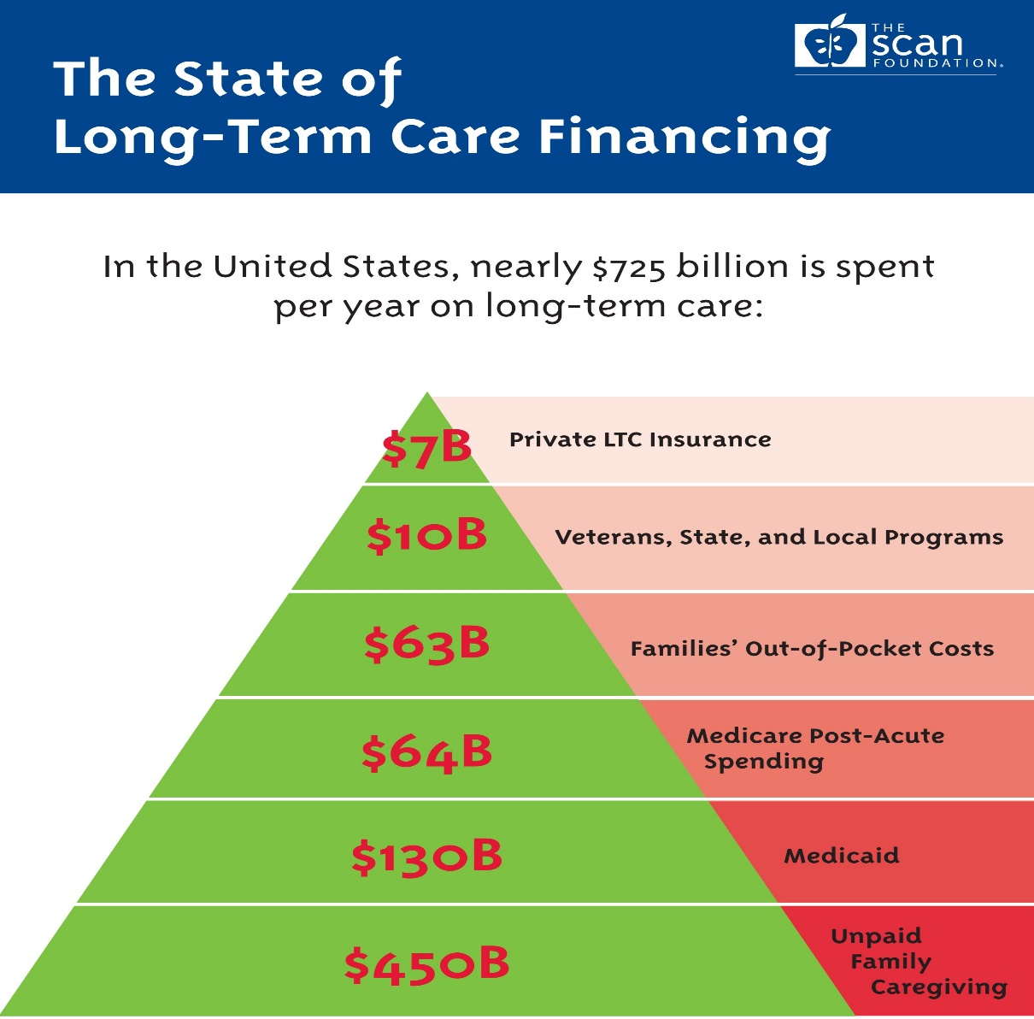
Who Pays for Long Term Care Nationally?
Source: SCAN Foundation 2014: www.scanfoundation.org

Slide 45

What Is Skilled Care?
Nursing or Rehabilitation Services
(physical, speech, or occupational therapy)
Must be delivered by licensed providers on a regular basis

Slide 46
What Medicare Covers:
Skilled Nursing Facility Care
(if preceded by 3-day hospital stay):
First 20 days -Medicare pays 100% of approved amount
Additional 80 days -Co-payment required $200 per day (2023)
Beyond 100 days -Medicare does not cover
in a benefit period
Home Health Care: No co-pays, but must meet Medicare’s “skilled care” requirements
Notes:
Per Benefit Period: if out of SNF for 60 days, benefit period begins again.
Home health care requires doctor’s order and that the person be “homebound.”

Slide 47

LTC Medi-Cal (Nursing Home Coverage)
An individual keeps:
$35 per month for personal care
$130,000 in countable assets
(home and car are exempt,
with “intent to return”)

Slide 48
LTC Medi-Cal (Nursing Home Coverage)
Married Couples Can Separate Assets
In 2023, the spouse/domestic partner at home can keep:
$3,715 in monthly income
$148,620 in “countable” assets
Visit www.canhr.org for more info on
Medi-Cal for Long Term Care
Notes:
The community spouse may be able to keep more income pending a court order or via the fair hearing process.
Under the “name on the instrument rule,” the community spouse may retain any income received in his/ her name alone, even if this exceeds the MMMNA. For example, if the community spouse’s monthly income (in his or her name alone) is $5,000, the community spouse may keep it all.
Resources acquired after the spouse is institutionalized and before he/she goes on Medi-Cal are not protected and will be counted at the time of application. However, once the spouse is eligible for Medi-Cal, any resources acquired after eligibility by the community spouse are protected and will not affect the institutionalized spouse's eligibility. For example, if the community spouse inherited $100,000 after the nursing home spouse was on Medi-Cal, she could keep this without affecting the other spouse's eligibility. Resources held prior to the spouse's institutionalization may be transferred under certain conditions.

Slide 49
Long Term Care Insurance:
Nursing Home Only
(Includes Assisted Living Facility Coverage)
Home Care Only
(Includes Adult Day Care, Hospice, and Respite Care)
Comprehensive
(Includes all of the above)

Slide 50

Medical Underwriting
Companies rarely sell to those with serious health conditions
A few may sell to those with chronic conditions for higher premiums
Health questionnaire with application and medical exam
Companies have 2 years to verify health info with medical records

Slide 51
LTC Insurance Policy Features
Daily benefit
  - ex: $80 - $300/day
Duration of benefits
  - ex: 1 year to lifetime
Length of waiting period (deductible)
  - ex: 0, 30, 60, 100 days
Inflation protection (optional)
-ex: 5% simple or compounded
Notes:
DAILY BENEFIT EXAMPLE: Mrs. Smith bought a policy with a daily benefit of $100 for each day of nursing home care. If the nursing home billed $150 each day, the policy would only pay the maximum daily benefit of $100, leaving a co-payment of $50 a day (equal to $1,500 a month) for Mrs. Smith to pay. Conversely, if the nursing home billed $85 a day, Mrs. Smith would only get the actual cost of $85 a day, not the maximum of $100 per day.

Slide 52
Additional Policy Features
Flexible Benefits
  -total amount can be used interchangeably
Care Management and Assessment
  -process to plan, coordinate and monitor LTC needs
Waiver of Premium
  -no more premiums due while collecting benefits
Non Forfeiture Benefit
  -shortened benefit period or return of premium
Notes:
Flexible benefits: LTC policies must allow the total amount of all of the policy benefits to be used interchangeably or in any combination of benefits covered by the policy. The daily maximums may still apply to SNF, home care, etc. but many policies today pay the same daily amount regardless of whether care is provided in a SNF, assisted living or at home.

Slide 53
When Benefits Become Available
Impairment in ADLs
  Inability to perform 2 – 3 ADLs
  Standardized definitions apply
  Expected to need care for 90 days or more
Cognitive Impairment
  Needing substantial supervision due to severe cognitive impairment
Notes:
The Benefit Triggers in a tax qualified long-term care insurance policy are:
1. Impairment in ADLs
ADLs are used to measure your physical abilities to determine if you qualify for benefits.
The law requires tax-qualified policies to pay or reimburse benefits if you are impaired in two out of the following six ADLs: bathing, dressing, transferring, eating, toileting, and continence.
An "impairment" in ADLs means that you need "substantial assistance either in the form of hands-on assistance or standby assistance due to a loss of functional capacity to perform the activity".
2. Impairment of Cognitive Ability
An "impairment of cognitive ability" means you need "substantial supervision due to severe cognitive impairment".
Note: Some companies also offer a non tax qualified long-term care insurance policy. The non tax qualified policy will include ambulating as a seventh ADL.
Definitions of ADLs California law requires one set of ADL definitions for policies using the California eligibility standards. A different set of ADL definitions are used in policies using the federal eligibility standards. These definitions describe each ADL. When a person cannot do one of them they have met one of the ADLs necessary to qualify for benefits. For example: “Bathing” in a tax qualified policy means, “washing oneself by sponge bath, or in either a tub or shower, including the act of getting into or out of a tub or shower.” However, “bathing” in a policy with California eligibility standards includes “cleaning the body using a tub, shower, or sponge bath, including getting a basin of water, managing faucets, getting in or out of the tub or shower, and reaching head and body parts for soaping, rinsing and drying.”

Slide 54
Premium Example:
Age | Annual Premium
50 | $4,096 - $8,034
65 | $5,332 - $9,378
80 | $15,767*
Source: CA Department of Insurance Website, Dec 2022
(Comprehensive, $100/day, 3 years, 30 day elimination period, with 5% compound inflation protection, tax qualified policy, for a female)
*Only 1 policy result met the criteria
Notes:
From main page of site, use navigation windows at right to choose “Buying Insurance” form the Consumer section, then select Compare Premiums, and then choose the link for 2013 Long Term Insurance rates (latest range that’s posted). The figures shown are for Individual Tax Qualified Comprehensive policies.

Slide 55

Long Term Care Rate and History Guide
The Insurance Commissioner must annually prepare a consumer rate guide for long-term care (LTC) insurance.
Overview of long-term care insurance - types of benefits and policies
Sample rates by company
Premium rate history report of each company that sells long term care insurance
Available on www.insurance.ca.gov/consumers
Notes:
The LTC rate history report is reported by the company and displays rate history for nationwide and/or California LTC policy forms for active companies (current LTC writers) and inactive (currently not writing LTC policies in California) companies.

Slide 56
Companies Selling LTCI in CA
Company Name | Company's Customer Service Number
Bankers Life and Casualty Company | (800) 621-3724
Genworth Life Insurance Company | (800) 456-7766
Knights of Columbus | (800) 380-9995
Mutual of Omaha Insurance Company | (800) 896-5988
National Guardian Life Insurance Company | (888) 505-2332
New York Life Insurance Company Northwestern Long Term Care Ins. Company | (800) 224-4582 (800) 890-6704
Thrivent Financial | (800) 847-4836
Notes:
2015 edition from Dept of Insurance website: https://www.insurance.ca.gov/01-consumers/105-type/95-guides/05-health/01-ltc/ltc-co-numbers.cfm

Slide 57

Taxes* and LTC Insurance
Federally Tax Qualified Policies sold since 1996
Pay when unable to perform 2 out of 6 ADLs
Benefits not taxed as income
Premiums are deductible as medical expense
    Health expenses must be above 7.5% of AGI in order to itemize.
    *Consult tax advisor
Notes:
To help finance the Affordable Care Act, the threshold for itemized deductions for unreimbursed medical expenses was raised from 7.5% to 10% of AGI starting Jan. 1, 2013. This threshold increase is waived for persons 65 & older for tax years 2013 through 2016.

Slide 58
CA Partnership for Long Term Care
Alliance between State of CA (DHCS), one participating insurance company + CalPERS
Partnership policies provide additional asset protection above Medi-Cal limits:
  Each $ paid out by policy protects
  equal dollar amount in assets
  Medi-Cal is back-up if needed
Policies are tax-qualified and must include inflation protection
Notes:
Built-in automatic inflation protection of 5 percent annually
Care coordination and monitoring by licensed health professionals independent of the insurance company to develop a plan of care based upon your individual needs and resources
Once-in-a-lifetime deductible so that if you stop using policy benefits and then must use them again, you will not have to pay a second deductible
Waiver of premium for all days your policy pays for care in a nursing or residential care facility
Medical asset protection to ensure a portion of your assets are protected should you need to rely on Medi-Cal
From rureadyca.org

Slide 59

Companies Selling Partnership Policies
These companies are certified to offer Partnership policies, however, NONE are currently selling or offering this coverage.
  Bankers Life and Casualty Company 1-800-621-3724
  CNA Life Insurance Company 1-800-262-1037
  Genworth Life Insurance Company 1-888-436-9678
  John Hancock Life Insurance Company 1-800-732-5543
  MetLife Metropolitan Life Insurance Company 1-888-687-0977
  New York Life Insurance Company 1-800-225-5695
  Transamerica Life Insurance Company 1-800-227-3740
  CalPERS Long-Term Care Program* 1-800-908-9119
Notes:
Based on the current list at http://rureadyca.org/partnership-certified-companies
Some companies have started selling policies with gender based pricing, women’s rates average 15% higher.

Slide 60

Cal PERS Plans
Offered to California public employees, retirees, spouses & other family members
Self-funded program; not an insurance company
  Comprehensive and Partnership tax-qualified plans
Need 3 of 6 ADLs to qualify (stricter criteria)
Flexibility in use of benefits (monthly pool)
Once per lifetime deductible
Application period now open with no closing date
Rate Increases (by 85%) in 2015 for most plans
For more information, go to https://www.calperslongtermcare.com/

Slide 61
Cal PERS Settlement
Settlement Not Final: Cal PERS rejected the settlement prior to the June 8, 2022 deadline so policyholders will not get any of the proposed settlement option.
Must continue to pay premiums
To remain eligible for premium refund
Lapse, claim, or die before June 8, 2022
Moves into a different category for damages
CalPERS can decline settlement
Too many people opt out of the settlement, or
Settlement puts LTCI program at risk of Insolvency
  Policyholder member of the lawsuit who wanted to keep their CalPERS coverage had to opt out of the Settlement by January 28, 2022. If the Settlement if made final and a policyholder has not opted out they will automatically get a refund of their premium and lose their CalPERS long-term care insurance policy. If you have any questions about the Settlement you can contact the Settlement Administrator at 1-866-217-8056 (Toll-Free)
For more information, go to https://www.calpersltcclassaction.com/Home/FAQ

Slide 62

Minimum Suitability Standards for LTCI
  Premiums no more than 7% of annual income
Non-housing assets of at least $50K
  Total coverage consistent with assets
Ability to absorb premium increases
  At least a 50% increase during lifetime
Notes:
National average premium increase for LTC policies, per Bonnie Burns, January 2014 is 40-50%...

Slide 63
Some Consumer Protections
Agents are required to provide Outline of Coverage
Agents must provide “LTC Insurance Personal Worksheet” to help evaluate financial suitability
Companies must provide 30 day “free look”
Policies must include “forgetfulness feature” for premium payment lapses
Companies must allow you to reduce
coverage for lower premium
Policies must be guaranteed renewable
Agents must refer prospective buyer to HICAP

Slide 64

Factors Which Influence Purchase
Health Status - chronic condition?
Age - over 80 or 84?
Income - premiums affordable?
Assets - enough to protect?
Heirs - to protect assets for?
Personal Situation - caregiver, family history?

Slide 65
Questions to Ask…
Can I afford this policy now, and in the future, if my income changes?
Have I compared several policies?
Have I researched companies?
Who can file claims if I’m unable?
Have I consulted someone else? Family? HICAP?

Slide 66
LTC Insurance Resources
www.longtermcare.gov (202) 619-0724
National Clearinghouse for Long Term Care Information
www.insurance.ca.gov (800) 927-HELP (4357)
CA Department of Insurance Rate and History Guide
www.rureadyca.org (916) 552-8990
California Partnership for Long Term Care
www.cahealthadvocates.org (800) 434-0222 (HICAP)
Consumer Information on Long Term Care
www.canhr.org (415) 974-5171 or (800) 474-1116
Consumer information on nursing homes, assisted living, Medi-Cal for LTC, and elder law attorney referrals
www.aging.ca.gov (916-419-7500)
California Department of Aging; can order or download Taking Care of Tomorrow - A Consumer’s Guide to Long Term Care

Slide 67

For an Appointment
with a HICAP Counselor in your area, call
(510) 839-0393 or statewide (800) 434-0222
www.lashicap.org
Are you looking for rewarding volunteer opportunities? Call our office or visit our website for more information about how you can become a Medicare counselor with HICAP.
If you would like us to present this information to a group or organization you know, call our office and ask for the community education department or speak to us before you leave.

